Slide 1



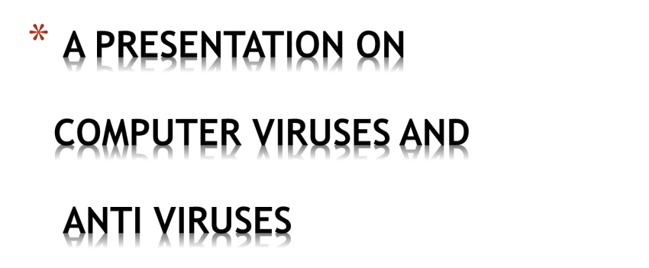



Slide 2





A Computer Virus is a computer
program that can copy itself and
infect a computer without permission
or knowledge of the user

Slide 3

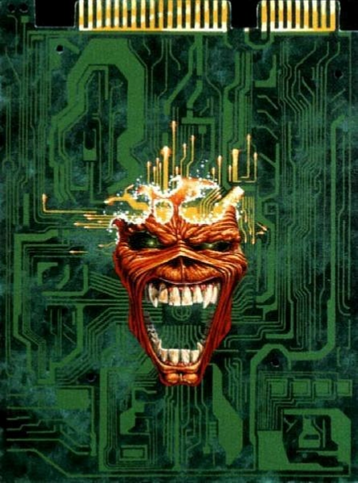
A virus can only spread
from one computer to
another when its host is
taken to the uninfected
computer, for instance by
a user sending it over a
network or the Internet,
or by carrying it on a
removable medium such
as a floppy disk, CD, or
USB drive.

Slide 4


On the basis of scale there are five types of
viruses under one name:
MALWARE
Spyware Adware Worms
Trojans
Rootkits

Slide 5
VIRUSES: WHAT THEY INFECT
1. System SectorViruses -DOS boot sector or the Master
Boot Record
2.
File Viruses -Program (COM and EXE) files
3. Macro Viruses -Data files having macro programs
4. Companion Viruses -EXE files by installing a same-named
COM file
5.
Cluster Viruses -Changes the DOS directory information so
that directory entries point to the virus code instead of the
actual program
6.
Source Code Viruses -Source code, by adding Trojan code
to it

Slide 6

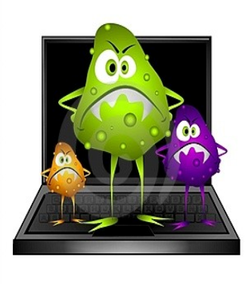
Malware, from the words
malicious and software, is
a software designed to
infiltrate or damage a
computer system without
the owner's informed
consent .It includes
spyware, adware,
computer worms and
trojan horses.

Slide 7

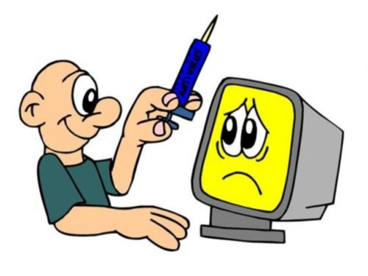
Spyware
computer
software that is installed
is
secretly
personal
computer to intercept or
take partial control over
the user's interaction with
the computer, without the
user's informed consent.
on
a

Slide 8


Adware or advertising-
supported software is any
software package which
automatically plays,
displays, or downloads
advertisements to a
computer after the
software is installed on it
or while the application is
being used.

Slide 9

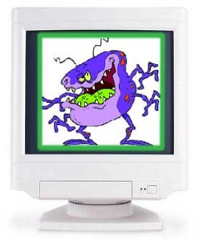
Computer Worm is a self-
replicating computer
program. It uses a network
to send copies of itself to
other nodes (computer
terminals on the network)
and it may do so without
any user intervention. It
always cause harm to the
network, if only by
consuming bandwidth

Slide 10

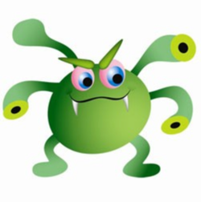
A Trojan, is malware
that appears to
perform a desirable
function but in fact
performs undisclosed
malicious functions

Slide 11


A Rootkit is a computer
virus which consists of a
program designed to take
fundamental control of a
computer system, without
authorization by the
system's owners and
legitimate managers.

Slide 12
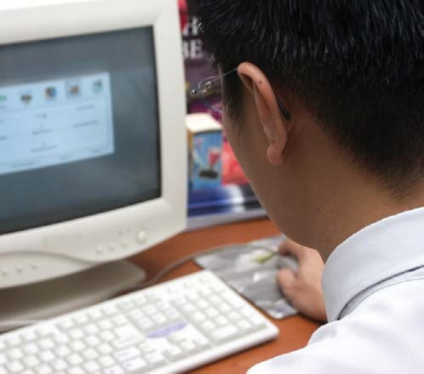
Signs of viruses:
➢
Operating
System
may
slow
down.
➢ Change the length of executable
(*.com/*.exe) files.
➢ Change to the reassignment of
system resources.
➢ Showing some funny and
suspicious behaviour (blinking of
the mouse).

Slide 13

ANTI - VIRUS

Slide 14

Anti-Virus Software are
computer programs that
attempt to identify,
neutralize or eliminate
malicious software. Most
modern antivirus software is
now designed to combat a
wide range of threats,
including worms, rootkits,
Trojans, often described
collectively as malware.

Slide 15

1. THE SIGNATURE
APPROACH:
Just like the police traces patterns in
crimes back to a criminal ,software
engineers can reverse engineer a
virus to find the signature it leaves .this
signature is added to the database so
that when buster performs a virus
scan, each file is scanned for matches
with any virus’ signature

Slide 16
2.THE SANDBOX APPROACH:
A ‘sandbox is an advanced
program that emulates an OS.A
suspect executable file is run
within the confines of a sandbox
and then the sandbox is examined
to see what changes were made.

Slide 17
3.THE HEURISTIC APPROACH:
This analyses a program for
‘seemingly’ malicious behavior
,heuristics is effective against
undocumented viruses .The buster of
the future might eliminate the need for
continual monitoring of new viruses.

Slide 18

1.Delete your browsing history, temporary
internet files, internet cookies before exiting .
2.Always remember to scan any removable
hardware using anti-virus software before accessing
it. Removable hardware includes Floppy Disks, CD,
USB Drive.
3.Scan your computer every week using anti-virus
software like Norton, McAfee for prevention against
malware
4.Update your anti-virus for new and latest virus definitions.
5.Create a system restore point before installing any software
or freeware.

Slide 19



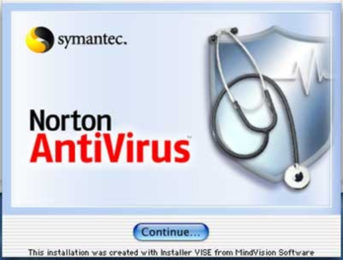



➢Kaspersky Anti-Virus
➢Norton Antivirus
➢AVG Antivirus
➢NOD32 Antivirus
➢Panda Antivirus

Slide 20
CONCLUSION:
•VIRUSES HAVE STIMULATED SCIENTIFIC
THINKING AND IDEAS
•SOME IDEAS CAN ALSO BE EXPORTED INTO
MEDICAL SCIENCE
•VIRUSES CAN ALSO BE PUT TO CONSTRUCTIVE
USE(GOOD VIRUSES)
•EACH USER MUST REALIZE THE GRAVE DANGER
POSED BY VIRUSES
•TAKE STEPS TO PREVENT INFECTION, AND IN
CASE OF INFECTION, PROPER AND SAFE WAYS OF
DEALING WITH THE INFECTION

Slide 21
THANK YOU!

